Slide 1
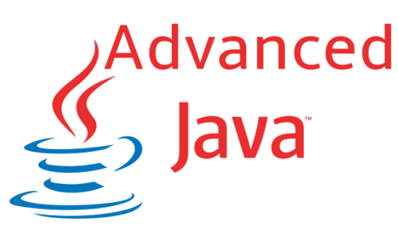

Functional Programming
Functions and Lambda Expressions
SoftUni Team
Technical Trainers
Software University
http://softuni.bg

Slide 2
Questions?
sli.do
#java-fund

Slide 3


Table of Contents
Lambda Expressions
What is a Function?
Function<T,R>
Other Function Types
Consumer<T>
Supplier<T>
Predicate<T>
BiFunction<T, U, R>
Passing Functions to Methods

Slide 4
What is a Function?
Mathematic function
Mathematic function
f(x) = x²
x
f(x)
Name
3 | 9
1 | 1
0 | 0
4 | 16
-4 | 16
Input
Output
A function is a special relationship where each input has a single output.

Slide 5

Lambda Expressions

Slide 6
Lambda Expressions
Lambda expression - unnamed function
Has parameters and a body
Use the lambda operator -> Read as "goes to"
Lambda Syntax
(parameters) -> {body}

Slide 7
Lambda Expressions (2)
Implicit lambda expression
Explicit lambda expression
(msg) -> { System.out.println(msg); }
Parameters can be enclosed in parentheses ()
The body can be enclosed in braces {}
String msg -> System.out.println(msg);
Declares parameters' type

Slide 8
Lambda Expressions (3)
Can have different number of parameters:
Zero parameters
More parameters
() -> { System.out.println("Hello!"); }
() -> { System.out.println("How are you?"); }
(int x, int y) -> { return x + y; }
(int x, int y, int z) -> { return (y – x) * z; }

Slide 9

Problem: Sort Even Numbers
Read Integers from the console
Print the even numbers
Sort the even numbers
Print the sorted numbers
4, 2, 1, 3, 5, 7, 1, 4, 2, 12
4, 2, 4, 2, 12
2, 2, 4, 4, 12

Slide 10
Solution: Sort Even Numbers
//TODO: Read numbers and parse them to List Of Integers
numbers.removeIf(n -> n % 2 != 0);
// TODO: Print the even numbers
numbers.sort((a, b) -> a.compareTo(b));
//TODO: Print the sorted numbers

Slide 11
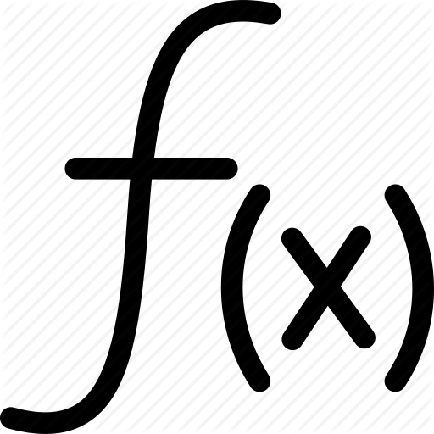
Functions
Mathematical and Java Functions

Slide 12
Java Functions
In Java we can create functions analogical to mathematical functions
f(x) = x²
Return expression
Output type
Input parameter
Function<Integer, Intger> func = x -> x*x;
Input type
Name
Lambda Expression

Slide 13
Function<T, R>
In Java Function<T,R> is an interface that accepts a parameter of type T and returns variable of type R
We use function with .apply()
int increment(int number) {
return number + 1;
}
Function<Integer, Integer> increment = number -> number + 1;
int a = increment.apply(5);
int b = increment.apply(a);

Slide 14

Problem: Sum Numbers
Read numbers from the console
Print their count
Print their sum
Use a Function
4, 2, 1, 3, 5, 7, 1, 4, 2, 12
Count = 10
Sum = 41

Slide 15
Solution: Sum Numbers
//TODO: Read input
if (input.length < 2) {
System.out.println("Count = " + input.length);
System.out.println("Sum = " + input[0]);
} else {
Function<String, Integer> parser = x->Integer.parseInt(x);
int sum = 0;
for (String s : input) {
sum += parser.apply(s);
}
//TODO: Print output
}

Slide 16
Other Function Types
Special Functions

Slide 17

Consumer<T>
In Java Consumer<T> is a void interface:
We use a Consumer with .accept():
void print(String message) {
System.out.println(message);
}
Consumer<String> print =
message -> System.out.print(message);
print.accept("Peter");

Slide 18

Supplier<T>
In Java Supplier<T> takes no parameters:
We use a Supplier with .get():
void genRandomInt()
Random rnd = new Random();
return rnd.nextInt(51);
Supplier<Integer> genRandomInt = () ->
new Random().nextInt(51);
int rnd = generateRandomInt.get();

Slide 19

Predicate<T>
In Java Predicate<T> evaluates a condition:
We use the Predicate with .test():
boolean isEven(int number) {
return number % 2 == 0;
}
Predicate<Integer> isEven =
number -> number % 2 == 0;
System.out.println(isEven.test(6)); //true

Slide 20

Problem: Count Uppercase Words
Read text from the console
Find the words starting with
an Uppercase letter
Print the count and the words
Use a Predicate
The following example shows how to use Predicate
2
The
Predicate

Slide 21
Solution: Count Uppercase Words
//TODO: Read text
Predicate<String> checkerUpperCase =
s -> s.charAt(0) == s.toUpperCase().charAt(0);
ArrayList<String> result = new ArrayList<>();
for (int i = 0; i < textAsList.length; i++) {
if (checkerUpperCase.test(textAsList[i])) {
result.add(textAsList[i]);
}
}
//TODO: Print results

Slide 22

Problem: Add VAT
Read some items’ prices from the console
Add VAT of 20% to all of them
1.38, 2.56, 4.4
Prices with VAT:
1,66
3,07
5,28

Slide 23
Solution: Add VAT
//TODO: Read input
List<Double> numbers = new ArrayList<>();
for (String s : input) {
numbers.add(Double.parseDouble(s));
}
UnaryOperator<Double> addVat = x -> x * 1.2;
System.out.println("Prices with VAT:");
for (Double str : numbers) {
System.out.println(String.format("%1$.2f",
addVat.apply(str)));
}

Slide 24

Bi Functions
Using Functions With More Parameters

Slide 25

BiFunctions
BiFunction <T, U, R>
Analogically you can use:
BiConsumer <T, U>
BiPredicate <T, U>
BiFunction <Integer, Integer, String> sum = (x, y) -> "Sum is" + (x + y);
Two input parameters

Slide 26

Problem: Sum Numbers
Read numbers from the console
Print their count
Print their sum
Use BiFunctions
4, 2, 1, 3, 5, 7, 1, 4, 2, 12
Count = 10
Sum = 41

Slide 27
Solution: Sum Numbers
//TODO: Read input
if (input.length < 2) {
System.out.println("Count = " + input.length);
System.out.println("Sum = " + input[0]);
} else {
BiFunction<String, String, Integer> parser =
(x, y) -> Integer.parseInt(x) + Integer.parseInt(y);
int sum = 0;
for (int i = 0; i < input.length - 1; i += 2) {
sum += parser.apply(input[i], input[i + 1]);
}
//TODO: Read input
}

Slide 28
Passing Functions to Method
We can pass Function<T,R> to methods:
We can use the method like that:
int operation(int number, Function<Integer, Integer> function) {
return function.apply(number);
}
int a = 5;
int b = operation(a, number -> number * 5); //b = 25
int c = operation(a, number -> number - 3); //c = 2
int d = operation(b, number -> number % 2); //d = 1

Slide 29
Problem: Filter by Age
Read from console n people with their age
Read a condition and an age so to filter them
Read format type for the output
Print all people that fulfill the condition
Pesho | 20
Gosho | 18
Radka | 29
Mara | 32
Ivan | 16
Pesho | 20
Radka | 29
Mara | 32
Condition - "older"
Age - 20
Format - "name age"

Slide 30
Solution: Filter by Age
//TODO: Read info from the console
Predicate<Integer> tester = createTester(condition, age);
Consumer<Map.Entry<String, Integer>> printer =
createPrinter(format);
printFilteredStudent(people, tester, printer);

Slide 31
Solution: Filter by Age (2)
private static Consumer<Map.Entry<String,Integer>> createPrinter(String format)
switch (format) {
case "name age":
return person -> System.out.printf("%s - %d%n", person.getKey(), person.getValue());
}
private static Predicate<Integer> createTester(String condition, Integer age) {
switch (condition)
case "younger":
return x -> x <= age;
}
Add more cases

Slide 32
Solution: Filter by Age (3)
public static void printFilteredStudent(
LinkedHashMap<String, Integer> people,
Predicate<Integer> tester,
Consumer<Map.Entry<String, Integer>> printer) {
for (Map.Entry<String, Integer> person : people.entrySet()) {
if (tester.test(people.get(person.getKey()))) {
printer.accept(person);
}
}
}

Slide 33
Summary
Lambda expressions are anonymous methods
Consumer<T> is a void function
Supplier<T> gets no parameters
Predicate<T> evaluates a condition
Function<T,R> is a function
that returns R type
BiFunction<T, U, R> accepts
two parameters
Functions can be passed like variables to methods

Slide 34
https://softuni.bg/trainings/courses

Slide 35













SoftUni Diamond Partners

Slide 36




SoftUni Organizational Partners

Slide 37




Trainings @ Software University (SoftUni)
Software University – High-Quality Education and Employment Opportunities
softuni.bg
Software University Foundation
http://softuni.foundation/
Software University @ Facebook
facebook.com/SoftwareUniversity
Software University Forums
forum.softuni.bg

Slide 38

License
This course (slides, examples, demos, videos, homework, etc.) is licensed under the "Creative Commons Attribution-NonCommercial-ShareAlike 4.0 International" license

